Slide 1
HIP Project Expo
Cincinnati Campus
January 8th, 2019
Molly Fisher
2019, Lakota West High School

Slide 2
Remove this slide when complete
General Guidance/Rules for 2014 Presentations- Titles, Segoe UI Font, size 28
Body bullets/wording on all slides will be Segoe UI Font, size 18
Top bullet will be a very brief overview of the project
Followed by 3 to 5 bullets describing what you did during your project
The Core Team reserves the right to “correct” your presentation
We suggest you use one of the example slides and overwrite your information on them, then remove all red text prior to submitting. If you have any questions/concerns, contact your Group Lead
Maximum of 6 content slides

Slide 3
Nick Perrin
Software Engineer
Richard Hammond
Software Engineer
Molly Fisher, Junior
Lakota West

Slide 4
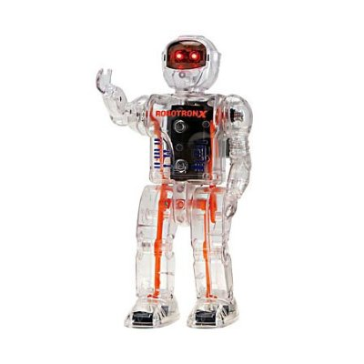
Project Description / Background
When I was first starting to drive I often had problems getting directions. My parents didn’t want me to drive on highways or specific roads, so I had to find my own way around. That gave me the idea to design an app that helps new drivers avoid dangerous routes.
New drivers often are not yet comfortable on the road and can easily be overwhelmed by an excess of traffic. Many apps that give directions only give the fastest routes when newer drivers need to take the safer ones
The goal of this app is to classify dangerous roads (where there are a high number of accidents), and to generate directions that avoid and/or show these area.

Slide 5
Approach / Process
Start to learn Swift via Apple’s “Food Tracker” tutorial
Employed Electrical and Computer Science Principles to develop:
App that utilized multiple functions and pages to control longboard
Piece multiple hardware components together to create a motorized longboard that could be controlled via phone app.
More to come!!!
storyboard for app.
Requirements
Detailed
Design
Fabrication
&
Assembly
Design Verification
& Test

Slide 6
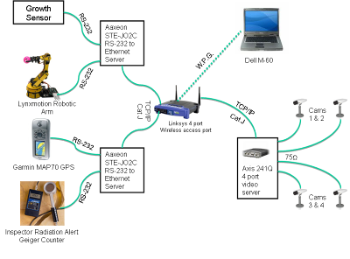
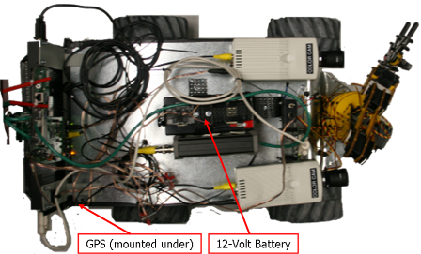
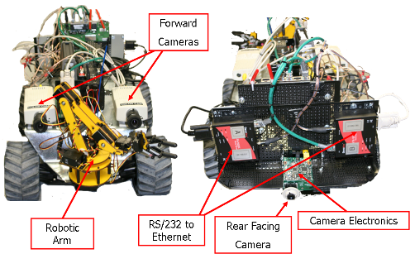
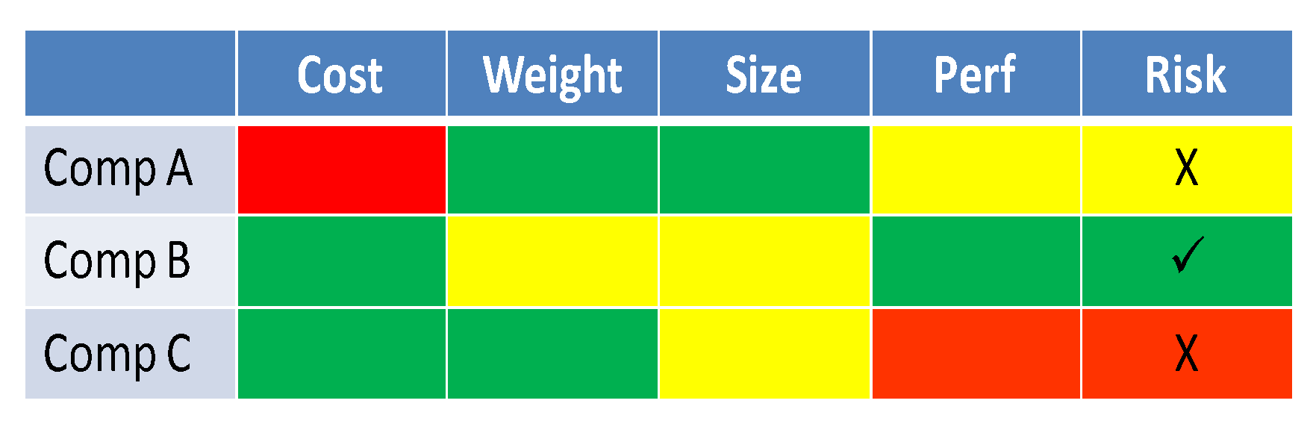
Analysis/Results
Explain the analysis and results of the project / design
Include a few bullets about the work done…all body text will be Segoe UI Font, size 18.
Completed risk analysis based upon key requirements
Comp B selected based upon cost/performance
Constructed and mounted all electrical/mechanical components
Installed all software to operate the components and vehicle
Tested entire system and all components successfully
If you choose to use photos, be consistent
Remove all Red text when complete

Slide 7
Learning Highlights /Conclusion
Learning Highlights
Assembled a robot that contains actuators, to create movement that responds with information
Mastered the modeling SW Unigraphics to design a 3-D motor assembly
Learned that budgeting is essential to real building projects
Learned the terms that are associated with assembling a robot
Learned that errors can change the scope of my project and how to cope with them
Conclusion:
Analysis shows that 23% parts used in the assembly had a shorter than expected shelf life.
Remember to keep your bullets concise and begin each bullet with a verb.
Remove all Red Text when complete

Slide 8
Future Work / Connection to NGC
Future Work
What could improve this project ? What area of research would make it more robust?
What are the next phases/steps?
What will you do next year?
Related Technology
Open Architecture
Multi-function sensor resource management
Autonomous vehicles/motion
Wireless communications
Data analysis
Cyber Security
Human Systems
Counter weapons of mass destruction
Include pictures if available!!!
Visit this link to determine which ES products your project relates to?
http://www.northropgrumman.com/Capabilities/Pages/default.aspx

